Slide 1


Intermediate Python
Realistic OOP Example

Slide 2
Incremental Class Design
Good class design evolves step by step as requirements grow.
Start with minimal attributes and behavior
Avoid over-design at the beginning
Add features incrementally
Refactor as responsibilities change
Let usage drive design decisions
Notes:
Emphasize that real software is not designed once. Show how requirements naturally expand. Encourage students to refactor instead of restarting.

Slide 3
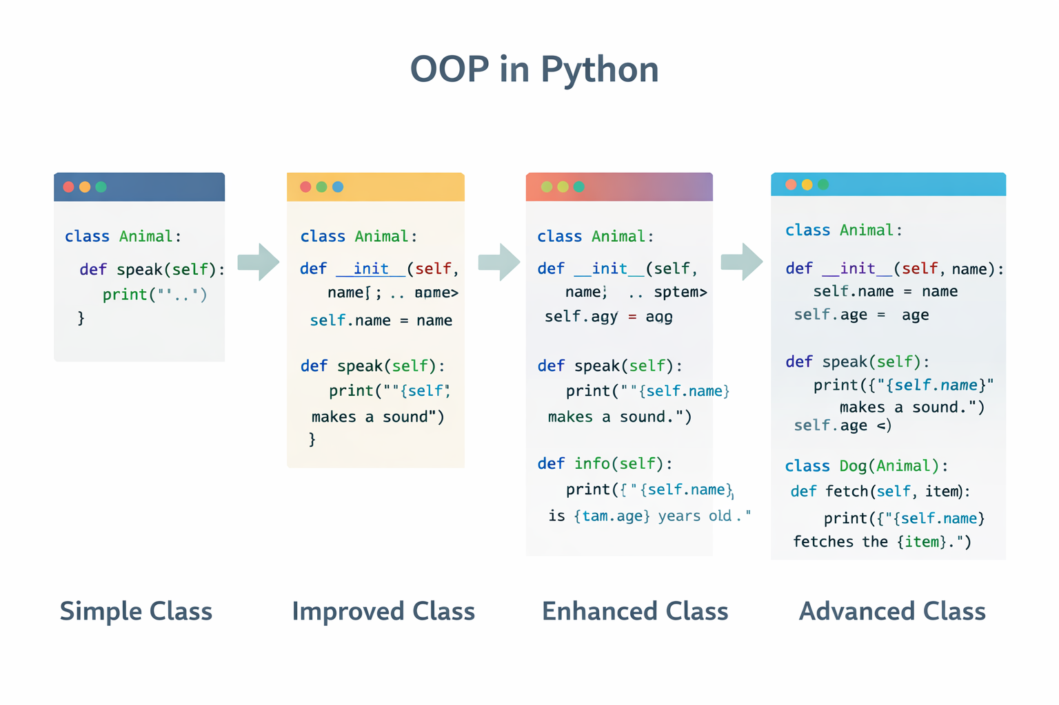

Slide 4
Example Python Code
# Step 1: Minimal design
class Account:
def __init__(self, owner):
self.owner = owner
# Step 2: Add behavior
class Account:
def __init__(self, owner, balance=0):
self.owner = owner
self.balance = balance
def deposit(self, amount):
self.balance += amount

Slide 5
Subclassing & Method Augmentation
Subclasses extend behavior without rewriting existing code.
Subclasses inherit existing functionality
New behavior can be added safely
Existing methods can be extended
super() allows reuse of parent logic
Supports open–closed principle
Notes:
Explain difference between overriding and augmenting. Show why calling super() preserves existing behavior. This mirrors real-world extension of systems.

Slide 6
Example Python Code
class Account:
def deposit(self, amount):
print("Depositing money")
class SavingsAccount(Account):
def deposit(self, amount):
super().deposit(amount)
print("Applying savings rules")

Slide 7
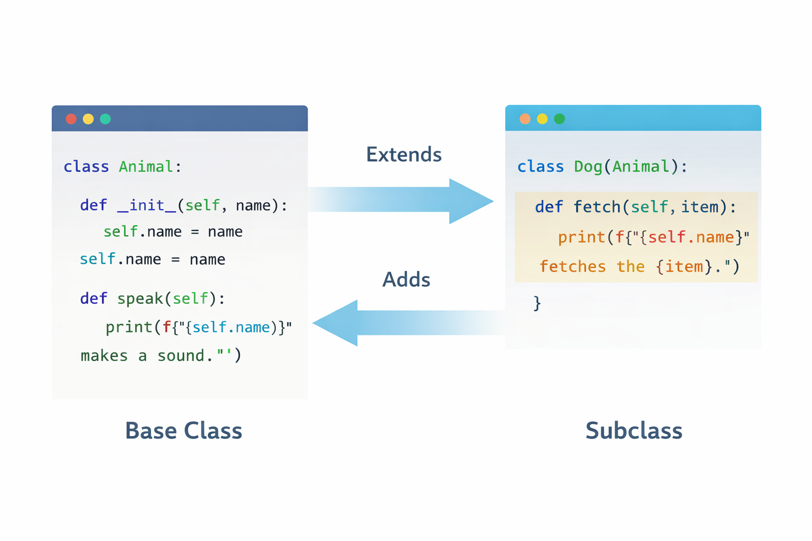

Slide 8
Polymorphism in Practice
Polymorphism allows different objects to respond to the same method call.
Same interface, different implementations
Reduces conditional logic
Enables flexible and scalable systems
Works naturally with inheritance
Central to clean OOP design
Notes:
Stress that the loop does not care about object type. Polymorphism replaces if/else trees. This is how frameworks and libraries scale.

Slide 9
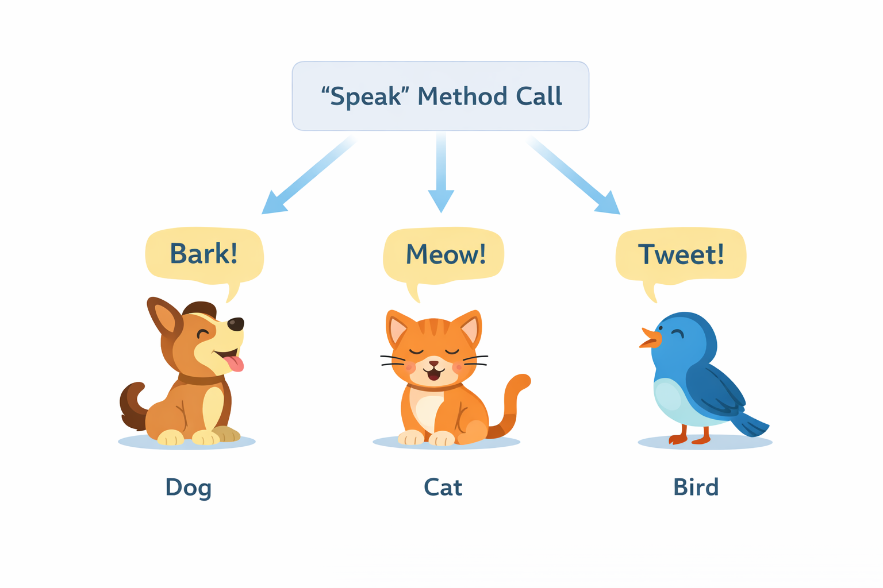

Slide 10
Example Python Code
class Account:
def calculate_interest(self):
pass
class SavingsAccount(Account):
def calculate_interest(self):
return "Savings interest"
class CurrentAccount(Account):
def calculate_interest(self):
return "No interest"
accounts = [SavingsAccount(), CurrentAccount()]
for acc in accounts:
print(acc.calculate_interest())

Slide 11
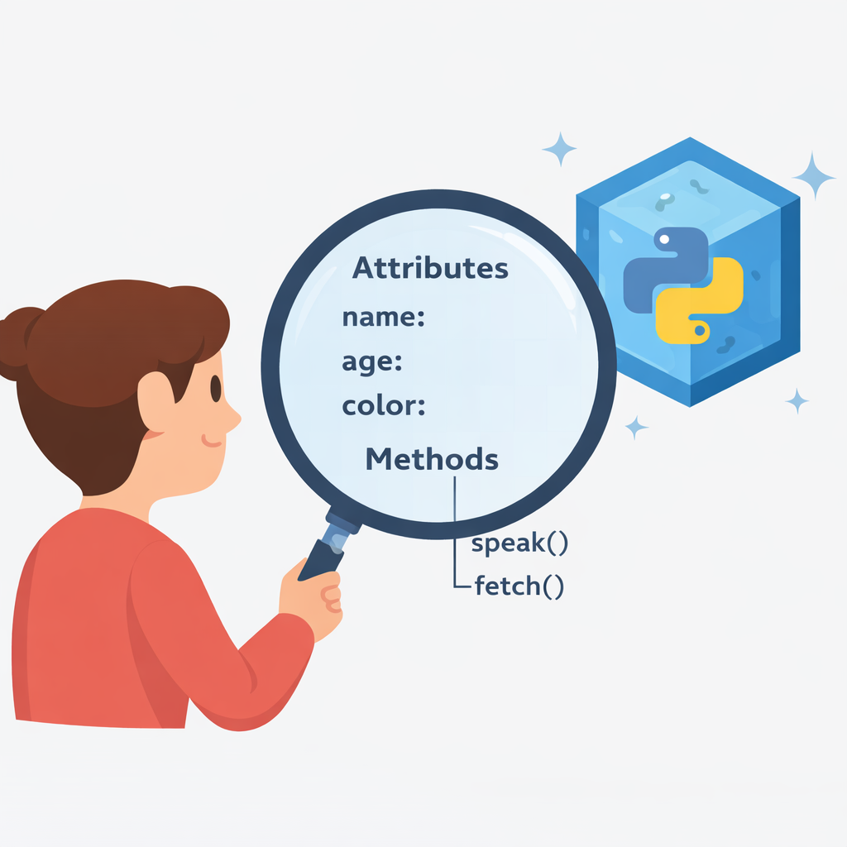
Introspection Tools
Python lets you inspect objects and classes at runtime.
Discover attributes dynamically
Inspect class structure
Useful for debugging and learning
Common in frameworks and tools
Supports reflective programming
Notes:
Explain that Python objects are self-describing. Show how dir() helps debugging. Mention that ORMs and serializers rely heavily on introspection.

Slide 12
Example Python Code
class User:
def login(self):
pass
u = User()
print(type(u))
print(dir(u))
print(hasattr(u, "login"))

Slide 13
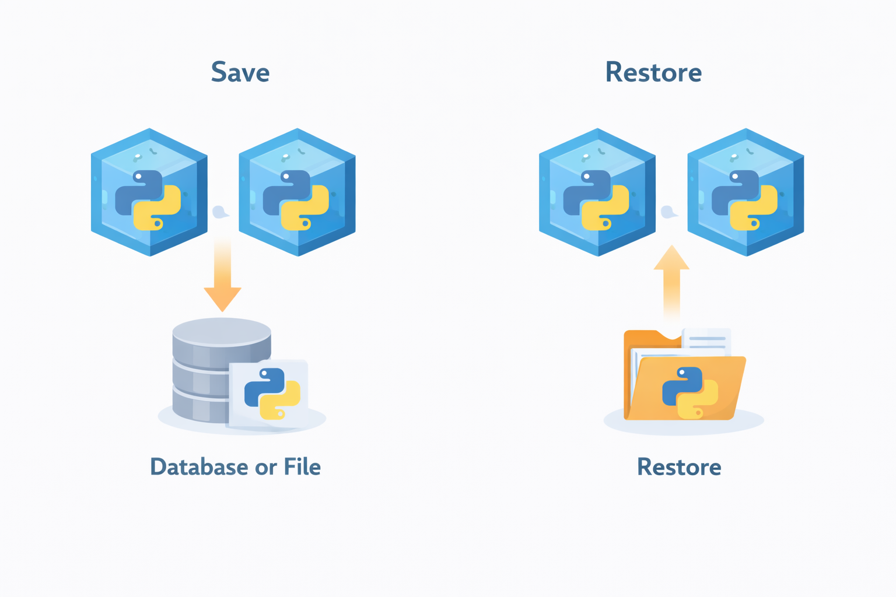
Pickle & Shelve Databases
https://docs.python.org/3/library/shelve.html
Objects can be stored and restored using Python’s built-in persistence tools.
pickle serializes Python objects
shelve provides key–value object storage
Useful for small apps and prototypes
Not suitable for untrusted data
Preserves object structure
Notes:
Clarify that pickle saves object state, not just data. Warn clearly about security risks. Position pickle/shelve as learning tools, not enterprise storage.

Slide 14
Example Python Code
with open("user.pkl", "wb") as f:
pickle.dump(u, f)
with open("user.pkl", "rb") as f:
loaded_user = pickle.load(f)
print(loaded_user.name)
import pickle
class User:
def __init__(self, name):
self.name = name
u = User("Aina")

Slide 15
Key Takeaways
Design evolves incrementally
Subclasses extend, not duplicate
Polymorphism simplifies logic
Python objects are introspectable
Objects can be persisted and restored

